Slide 1
CS 540 Database Management Systems
Lecture 11: Parallel DB & Map/Reduce
Some slides from Kevin Chang’s 511 slides

Slide 2
Parallel vs. Distributed DB
Fully integrated system, logically a single machine
No notion of site autonomy
Centralized schema
All queries started at a well-defined “host”

Slide 3
Parallel data processing: performance metrics
Speedup: constant problem, growing system
small-system-elapsed-time
big-system-elapsed-time
linear speedup if N-system yields N-speedup
Scaleup: ability to grow both the system/problem
1-system-elapsed-time-on-1-problem
N-system-elapsed-time-on-N-problem
linear if scaleup = 1
some problems have super-linear increase in cost
e.g., nlog(n) of sorting

Slide 4
Natural parallelism: relations in and out
Pipeline:
piping the output of one op into the next
Partition:
N op-clones, each processes 1/N input
Observation:
essentially sequential programming
Any
Any
Sequential
Sequential
Program
Program
Sequential
Sequential
Any
Any
Sequential
Sequential
Sequential
Sequential
Program
Program
Notes:
Intuitions for both pipeline and partition:
horizontal decomposition (to single tuples or small chunks), and processed in sequence or concurrently

Slide 5
Speedup & Scaleup barriers
Startup:
time to start a parallel operation
e.g.: creating processes, opening files, …
Interference:
slowdown for access shared resources
e.g.: hotspots, logs
communication cost
more I/O access
Skew:
if tuples are not uniformly distributed, some processors may have to do a lot more work
service time = slowest parallel step of the job
optimize partitioning, #workers, …

Slide 6
Speedup

Slide 7
Parallel Architectures
Shared memory
Shared disks
Shared nothing
?? Pros and cons?
software development (programming)?
hardware development (system scalability)?

Slide 8
Architecture: comparison
Shared Memory
Shared Disk
Shared Nothing
Easy to program
Difficult to build
Difficult to scaleup
Hard to program
Easy to build
Easy to scaleup
Oracle RAC
Teradata, Tandem, Greenplum
Winner will be hybrid of shared memory & shared nothing?
e.g.: distributed shared memory (Encore, Spark)
Notes:
36
- Shared nothing: Good for DB applications– Data centers, Web servers. Relatively independent tasks (queries).

Slide 9
(Horizontal) data partitioning
Relation R split into P chunks R0, ..., RP-1, stored at the P nodes.
Round robin
tuple ti to chunk (i mod P)
Hash based on attribute A
Tuple t to chunk h(t.A) mod P
Range based on attribute A
Tuple t to chunk i if vi-1 < t.A < vi
Over different architectures?
Why not vertical?
Load balancing? directed query?

Slide 10
Horizontal Data Partitioning
Round robin
query: no direction.
load: uniform distribution.
Hash based on attribute A
query: can direct equality
load: somehow randomized.
Range based on attribute A
query: range queries, equijoin, group by.
load: depending on the query’s range
of interest.
Index:
created at all sites
primary index records where a tuple resides

Slide 11
Query execution
Query manager
parse and optimize query, generate operator tree.
Send to site (if a single site query), or dispatcher
Dispatcher
give query to a scheduler (simple load balancing)
Scheduler
pass pieces to operator processes at sites
Site query processor with query processes
results sent through scheduler to query manager.

Slide 12
Control Messages
3-times as many as operators in query tree
Scheduler → Processor: initiate
Processor → Scheduler: ID or port to talk to
e.g., for later data movement
Operator → Scheduler: Done

Slide 13
Selection
Selection(R) =
Union (Selection R1, …, Selection Rn)
Initiate selection operator at each relevant site
If predicate on partitioning attributes (range or hash)
Send the operator to the overlapping sites.
Otherwise send to all sites.

Slide 14
Hash-join: centralized
R
OUTPUT
Partitions
1
Partition relations R and S
R tuples in bucket i will only match S tuples in bucket i.
1
INPUT
2
hash
function
2
. . .
M-1
M-1
Disk
M main memory buffers
Disk
Partitions
of R & S
Join Result
Read in a partition of R. Scan matching partition of S, search for matches.
Blocks of bucket
Ri ( < M-1 pages)
Input buffer
For Si
Output
buffer
Disk
M main memory buffers
Disk
Notes:
14

Slide 15
Parallel Hybrid Hash-Join
M Joining Processors
(later)
R₂₁
R_{2k}
R₁₁
R_{1M}
R_{N1}
R_{Nk}
joining split table
K Disk Sites
R₁
R₂
R_{N}
partitioning split table
so that R_{i} fits into M processors
building relation R
Notes:
Review original Hybrid Hash Join: build R, build S, do (Ri, Si)

Slide 16
Aggregate operations
Aggregate functions:
Count, Sum, Avg, Max, Min, MaxN, MinN, Median
select Sum(sales) from Sales group by timeID
Each site computes its piece in parallel
Final results combined at a single site
Example: Average(R)
what should each Ri return?
how to combine?
Always can do “piecewise”?
Notes:
Piecewise not always possible: e.g. Median(), MaxN, MinN

Slide 17
Performance Results
Almost linear speedup and constant scaleup!
Close to perfect
almost expected
little startup overhead
no interference among disjoint data/operations
major operations (equijoin) insensitive to data skew
Notes:
insensitive to data skew: only “amount” of data matters for equijoin (can partition right)
if arbitrary predicates would be different

Slide 18
Other research issues Missing
Concurrency control
2PL
centralized deadlock detector
Recovery management using ARIES
Log manager in each site
Missing
query optimization for parallel execution
load balancing
skew handling

Slide 19
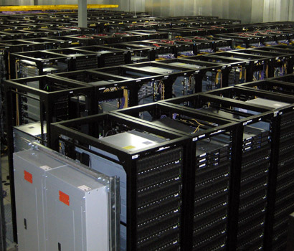
Cluster
Large number (100 – 100,000) of servers, i.e. nodes
connected by a high speed network
many racks
each rack has a small number of servers.
If a node crashes once a year, #crashes in a cluster of 9000 nodes
every day?
every hour?
Crash happens frequently
should handle crashes
Notes:
assuming uniformity: one each hour

Slide 20
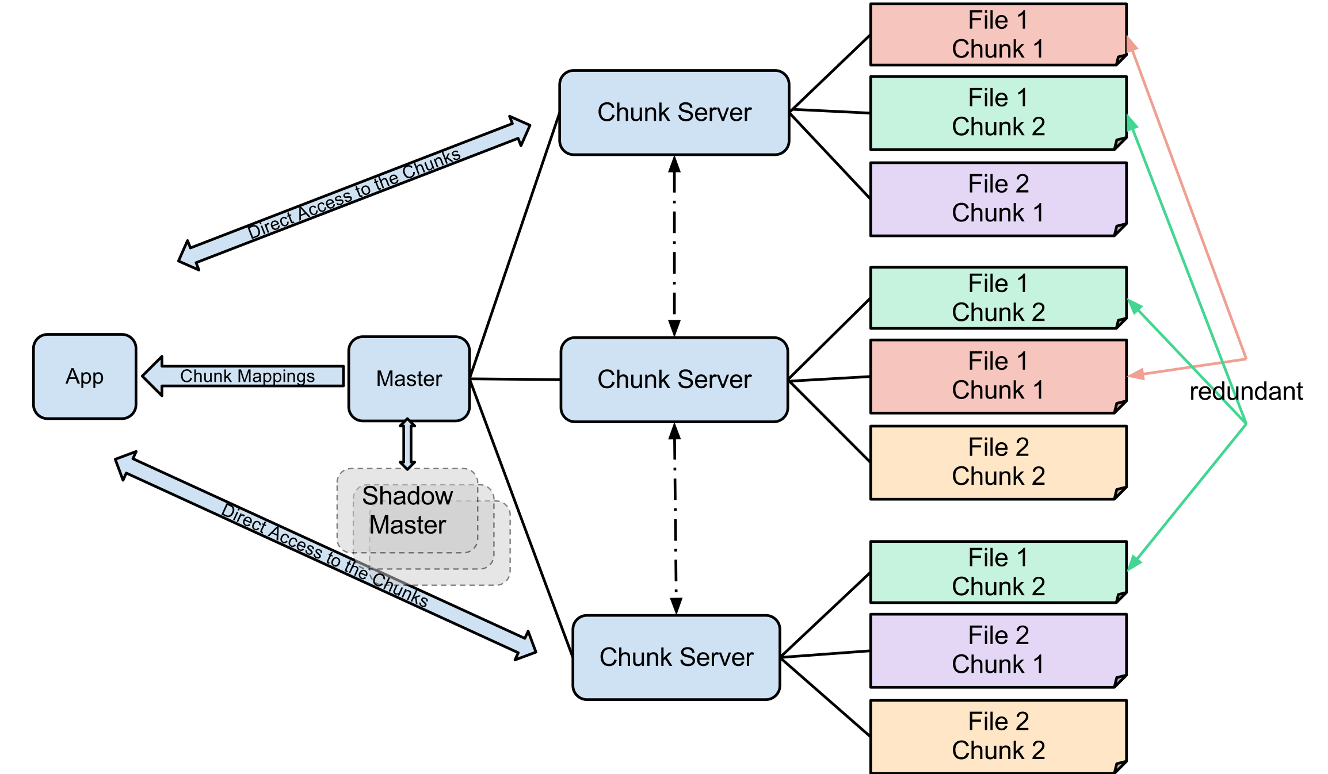

Distributed File System (DFS)
Manage large files: TBs, PBs, …
file is partitioned into chunks, e.g. 64MB
chunk is replicated multiple times over different racks
Implementations: Google’s DFS (GFS), Hadoop’s DFS (HFS), …
Notes:
The connection between application and chunk nodes depends

Slide 21
Parallel data processing in cluster
Data partitioning
partition (or repartition) the file across nodes
compute the output on each node
aggregate the results
Other types of parallelism?
Map/Reduce:
programming model and framework that supports parallel data processing
proposed by Google researchers; natural model for many problems
data model
bag of (key, value) tuples
input: bag of (input_key, value)
output: bag of (output_key, value)
Notes:
Another type of parallelism is pipelining.
Input and output of M/R program may have different keys.

Slide 22
Map/reduce
M/R program has two stages
map:
input = (input_key, value)
extract relevant information from each input tuple.
output = bag of (intermediate_key, value)
similar to Group By in SQL
reduce:
input = (intermediate_key, bag of values)
aggregate the information over a bag of tuples
summarize, filter, transform, …
output = bag of (output_key, value)
similar to aggregation function in SQL
Notes:
System applies the map function in parallel to all (input key, value) pairs in the input file.
System groups all pairs with the same intermediate key, and passes the bag of values to the REDUCE function

Slide 23
Example
Counting the number of occurrences of each word in a large collection of documents
map(String key, String value){
//key: document id
//value: document content
for each word w in value
Output-interim(w, ‘1’);
}
reduce(String key, Iterator values){
//key: a word
//values: a bag of counts
for each v in values
result += parseInt(v);
Output(String.valueOf(result));
}
Notes:
Hadoop implementation

Slide 24

Example: word count
DFS
DFS
Local Storage

Slide 25
Inside M/R framework
Master node:
partitions input file into M splits, by key.
assigns workers (nodes) to the M map tasks.
usually: #workers < #map tasks
keeps track of their progress.
Workers write output to local disk, partition into R regions
why local disk?
Master assigns workers to the R reduce tasks.
usually: #workers < #reduce tasks
Reduce workers read regions from the map workers’ local disks.

Slide 26
Fault tolerance
Master pings workers periodically
If down then reassigns the task to another worker.
Straggler node
takes unusually long time to complete one of the last tasks, because:
the cluster scheduler has assigned other tasks on the node
bad disk forces frequent correctable errors, …
stragglers are a main reason for slowdown
M/R solution
backup execution of the last few remaining in-progress tasks

Slide 27
Optimizing M/R jobs is hard!
Choice of #M and #R:
larger is better for load balancing
limitation:
master overhead for control and fault tolerance
needs O(M×R) memory
typical choice:
M: number of chunks
R: much smaller;
rule of thumb: R=1.5 * number of nodes
Over 100 other parameters:
partition function, sort factor,….
around 50 of them affect running time.

Slide 28
Discussion
Advantage of M/R
manages scheduling and fault tolerance
Disadvantage of M/R
limited data model and queries
difficult to write complex programs
testing & debugging, multiple map/reduce jobs, …
optimization is hard
Remind you of a similar problem?
reapply the principles of RDBMS implementation
declarative language, query processing and optimization, …
Repeats by every technological shift
sensor data => Stream DBMS, spreadsheets => Spreadsheet DBMS, …
it is important to learn the principle!

Slide 29
Parallel RDBMS / declarative languages over M/R
Hive (by Facebook)
HiveQL
SQL-like language
open source
Pig Latin (by Yahoo!)
new language, similar to Relational Algebra
open source
Big-Query (by Google)
SQL on Map/Reduce
Proprietary
…

Slide 30
What you should know
Performance metrics for parallel data processing
Parallel data processing architectures
Parallelization methods
Query processing in Parallel DB
Cluster computing & DFS
Map/Reduce programming model and framework
Advantages and Disadvantages of using Map/Reduce

Slide 31
Carry away messages
Usability
Map/Reduce was easier to use over new platforms
There is still a lot of space for improvement.
Sometimes, we have to re-build a framework
parallel databases => M/R => parallel DB over M/R

